Slide 1
#141: ACT for Obesity and Weight-Related Stigma: Concept and Treatment
Chair - Sarah Potts, M.S.
Discussant - Emily Sandoz, Ph.D.
________________________________________________________________________________________________________________
Jason Lillis, Ph.D. (Miriam Hospital, Brown Medical School)
Emily Squyres, M.S. (University of Louisiana Lafayette)
Sarah Potts, M.S. (Utah State University)
Notes:
10:30-35 Introduction of symposium, discussant and presenters, and review goals of presentation emphasis, and give directions for presenting style 15 minutes per presenter with hand up at 5 minutes and finger up at 1 minute (10 min)
10:40-10:55 – Jason Lillis presents
11-11:15 – Emily presents
11:20-11:35 – Sarah presents
11:40-12:00 – Emily leads discussion, key questions are offered from group as well, presenters offer questions as needed

Slide 2
Symposium Goals
Discuss role and significance of values consistent behavior within weight loss and weight-related interventions.
Explain role of psychological inflexibility and negative stereotypes as predictor of increased perceived self-stigma.
Analyze the relationship between experiences of stigmatizing events, disordered eating behaviors, and psychological flexibility for those struggling with obesity.

Slide 3
A randomized controlled trial for weight loss targeting individuals with high internal disinhibition: The Acceptance Based Behavioral Intervention (ABBI) trial
Jason Lillis, Ph.D.^{1,2}, Heather Niemeier, Ph.D.³, Jessica Unick, Ph.D.^{1,2}, Kathryn Ross, Ph.D.^{1,2}, Tricia Leahey, Ph.D.⁴, Katie Kendra, Ph.D.^{1,2}, and Leah Dorfman, Ph.D.¹
1-The Miriam Hospital, 2-Brown Medical School, 3-University of Wisconsin, 4-University of Connecticut

Slide 4
You’re fat!: Is psychological flexibility related to stigmatizing experiences and disordered eating for the obese?
Emily Squyres, M.S.^{1,2} and Emily Sandoz, Ph.D.¹
1-University of Louisiana Lafayette,
2-Lousiana Tech University

Slide 5
Delivering Acceptance and Commitment Therapy through guided self-help for weight self-stigma: Results from an open pilot trial
Sarah Potts, M.S.¹, Michael Levin, Ph.D.¹, Jack Haeger, B.A.¹, and Jason Lillis, Ph.D.²
1-Utah State University,
2-The Miriam Hospital and Brown Medical School

Slide 6
Background
Obesity is a costly public health problem in the US (Lenz et al., 2009; Wadden et al., 2002)
Impacts number of health variables
Lower life expectancy (Peeters et al., 2003)
Decreased quality of life (QOL) (Fontaine & Barvosky, 2001)
Range of psychological problems (Scott et al., 2009)
Increased depression and anxiety
Insufficient psychosocial weight-loss interventions
5-15% weight loss (Wadden et al., 2012)
Weight regain (Elfhag, 2005)
Notes:
Possible that we need to place more emphasis on setting these individuals up for success. Weight is only impacted by physical characteristics, but significantly maintained by psychological characteristics. Elfhag (2005) found patients who were more successful at weight maintenance (keeping weight off for at least 6 months) were also more psychologically equipped (psych strength, better able to handle stress, better coping strategies).

Slide 7
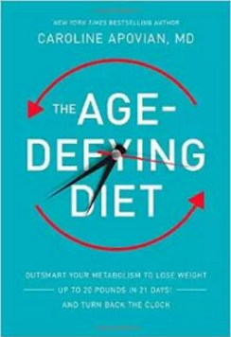
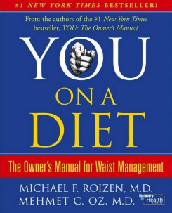
“Maybe I can Just Try One More Diet”

Slide 8
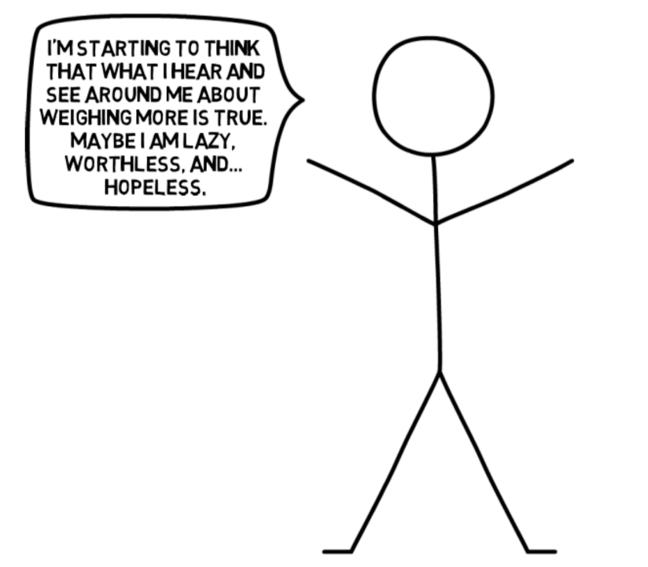

Slide 9
Role of Weight Stigma
Prevalent in societal structure, age ranges, workplaces, etc.
Common thought: stigmatizing attitudes might encourage and motivate
Increased problematic behavior, unhealthy choices, and avoidance of physical activity (e.g., Ashmore et al., 2008; Jensen at el., 2009)
Weight self-stigma
Internalized stigma from external environment
Applying beliefs to self
Contributes to psychological distress, binge eating (Lillis, Levin, & Hayes, 2011)
Greater predictor of QOL than BMI (Lillis, Luoma, Levin, & Hayes, 2009)
Notes:
Obese people are seen as undesirable, unintelligent, less competent, and lacking in self-discipline (Allison, Basile, & Yuker, 1991) and these attitudes are evident among co-workers, strangers, friends, romantic partners, and, most frequently, family members (Puhl & Brownell, 2006).
Prevalent in societal structure, age ranges, workplaces, etc.
Common thought: stigmatizing attitudes might encourage and motivate
Research suggests weight stigma is related to increased problematic behavior, unhealthy choices, and avoidance of physical activity (e.g., Ashmore et al., 2008; Jensen at el., 2009)
Weight self-stigma
Internalized stigma from external environment
Applying beliefs to self
Contributes to psychological distress, binge eating (Lillis, Levin, & Hayes, 2011)
Greater predictor of QOL than BMI (Lillis, Luoma, Levin, & Hayes, 2009)

Slide 10
Application of ACT
Aware: Noticing internal experience and recognizing patterns of behavior
Moving Forward: Being with self and accepting all experiencing while going towards what’s important
Open: Acceptance for experience, whether or not pleasant
Active: Doing things that align with what’s important
Notes:
Weight-related issues:
-Difficulty with weight loss and regain
-Unhealthy behavior patterns
-Psychological distress
-Low quality of life

Slide 11
Self-Stigma and ACT
Preliminary research for people with weight self-stigma (Lillis et al., 2009)
Previous efficacious interventions for addictions (Luoma et al., 2012) and LGBT populations (Yadavaia & Hayes, 2012)
ACT targets self-stigma
Increase awareness for thoughts and what one does with them
Notice patterns of behavior, cycle of suffering, or self-story” tanglledness”
Encourages stepping out of self-stories, noticing more choices
Making choices aligned with values

Slide 12
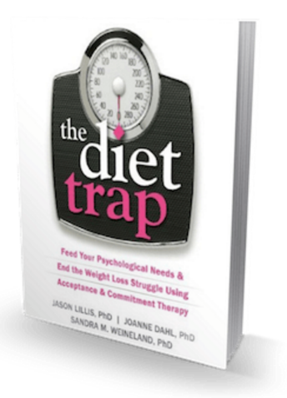
Guided Self-Help Approach
Notes:
Jason Lillis and Joann Dahl and Sandra Weinland
Personalized feel, probably many of you have rec a book, asking for a friend, what can I do… we know books can be addit useful treatment
Personalized feel
Patients might feel more open to seeking treatment
Recommending books = common
Avoids barriers such as training providers
Guidance with self-help promotes adherence, engagement, and application (Cuijpers et al., 2010)
Dissemination is cost-effective

Slide 13
Current Study
Feasibility of guided self-help ACT with limited support (supportive accountability via coach)
What is acceptable for obese individuals struggling with weight self-stigma?
What kinds of changes do we see regarding weight self-stigma, weight-related outcomes, eating behaviors, diet/exercise, quality of life, and depression?

Slide 14
Study Methods
Recruitment:
October 2014 to November 2015
Letters to providers, flyers in community areas, advertisements on campus screens
Inclusion:
BMI of 27.5 or greater
Score of at least 36 on Weight Self Stigma Questionnaire (WSSQ; Lillis et al., 2010)
Previous participation in weight loss programs in previous 2 years
Between 21 and 70 years old
Exclusion:
Recent weight loss of 5% or more of total weight
Current or planning pregnancy in next year
Current chest pain, dizziness, and/or Cardiovascular Disease
Serious psychological disorder

Slide 15
Participant Flow
23 initially interested
8 ineligible
15 eligible
13 enrolled
2 did not enroll in study
10 completed study
3 dropped out of study
90% female
90% White (1 participant Asian American)
35.10 (12.63) years old
BMI: 34.11 (5.21)
Notes:
Three participants dropped out of the study within the first three weeks of using the self-help book (two participants had family crises, one participant stopped after baseline for unclear reasons). These 3 dropouts were excluded from reported analyses, leaving a final sample of 10 participants.
All participants reported previous experience using weight loss strategies, with the most frequent past strategies including integrating exercise outside a structured class (80%), following a diet program (80%), commercial weight loss program (70%), exercise classes (70%), limiting/changing diet outside a program (70%), meeting with a dietician (50%), meeting with a physician (50%), and prescription medications or over-the-counter diet pills (50%).

Slide 16
Study Procedures
1)
Screening
2)
In-Person Appointment
3) Intervention
BMI
weight loss program history
weight self-stigma
randomized to A or B coach if eligible
interview with phone coach
reasons and desires for participation
supportive accountability
therapy!
7-weeks
The Diet Trap
journal
chapter quiz
coaching session
Notes:
Open trial, within group design
All participants are entered into study after completing baseline measurements
Participants are randomized to researcher A or B
Screening
Age, BMI, weight loss program hx., health and psychological diagnoses, WSSQ
In-Person Appointment
Consent for participation, baseline assessment, breath holding assessment, interview with phone coach, discussing reasons and desires for participation
Guided Self-Help Intervention
7-week intervention
Reading The Diet Trap, 1 chapter per week
Journaling activities (within book)
Weekly mini-quiz online
Weekly phone coaching session with personal coach
Promote engagement, encouraging use of book, aiding in generalizing program’s content to participant’s life
Not providing therapy
Final (7th) coaching session is in-person
Summary of gains, changes throughout intervention, post assessment, breath holding assessment

Slide 17
INTERVENTION
JOURNAL
BOOK
QUIZ
Weekly Phone-Coach Session
2 in-person appointments
weekly phone coaching sessions
Notes:
First in-person appointment:
Framed around gaining study involvement, engagement in completing the book and associated activities
Increase buy in for study and establish rapport between participant and coach
Weekly phone coach session:
5-10 minutes brief check-in (NOT adj. ACT treatment)
Supportive accountability in continuing to read the book
Open for discussing questions/related concerns to the book and how it applied to their lives
Last in-person appointment:
Recap on what was learned, help debrief the participant, discuss any treatment maintenance issues, and support relapse prevention

Slide 18
Important Ingredients of Phone Coaching
Legitimacy
Expectations
Addressing Non-Adherence
Accountability
Monitoring
Reinforce Adherence
Obvious Benefits
Motivation
Goal-Setting
Notes:
Supportive Accountability
These general principles were adopted from Duffecy et al. (2011) – phone coaching within internet interventions.

Slide 19
Results
Intervention completion: 83% participants completed (at least ½ of intervention coaching sessions)
Maintained improvements on a number of variables
Important data going forward regarding user-centered designs, phone coaching in self-help
Notes:
All analyses were conducted with 10 study completers, as the 3 drop-outs did not complete at least 50% of the study.
MMRM (mixed model repeated measures) were used in order to model missing data, there were two participants who did not complete follow-up.
All improvements in processes remained significant at 3-month follow up relative to baseline with large effect sizes ranging between 1.72 and 3.08.
Results indicated a high degree of program engagement (83% completed the intervention) and satisfaction. Participants improved on outcomes over time including weight self-stigma, emotional eating, weight management behaviors, health-related quality of life, and depression.
Participants improved on objectively measured weight, with an average of 4.18 pounds lost over 7 weeks, but did not improve on self-reported weight at 3 month follow up.
Processes of change improved over time, including psychological inflexibility, valued action and reasons to lose weight. Coaching effects indicated greater retention and improvements over time with one coach vs. the other, suggesting that the coaching variable mattered for outcomes. Implications of these results and how to address clinical challenges with guided self-help are discussed.

Slide 20
Program Components
Quiz completion: 9/10 completed all, 1 participant- 71%
Quiz score: M=93% (SD=8%)
Phone coaching completion: all 10 completed weekly, average session count=6 (7=scheduled**)
Reading book: 95-100%
Quality of reading the book: M=5.3 (SD=.68)
Book exercises: M=3.8 (SD=.63) (*helpful though!)
Reading post study: 25% used between post & F.U.
Journal post study: 37% “
Using exercises post study: 63% “
Notes:
Reading the book – 1-6 rating with 6 being very much, 5 being quite a lot
Post engagement really varied – not that surprising though… why would you continue re-reading the book

Slide 21
Outcome Measures – Weight Self-Stigma
Notes:
Weight Self-Stigma Questionnaire (WSSQ; Lillis et al., 2010). The 12-item WSSQ was used as the primary outcome measure of weight-related self-stigma. This scale yields a total score as well as two subscales: self-devaluation and fear of enacted stigma (i.e., fear of being stigmatized by others due to obesity). Items are rated on a 5-point scale ranging from 1 “completely disagree” to 5 “completely agree.” Prior studies have found the WSSQ to have good reliability and validity (Lillis et al., 2010) and particular sensitivity to ACT treatment effects among individuals struggling with obesity (Lillis et al., 2009). The WSSQ had adequate internal consistency in the current study, α = .81.

Slide 22
Outcome Measures – Emotional Eating (subscale)
Notes:
Dutch Eating Behavior Questionnaire-Emotional Eating (DEBQ-EE; Van Strien et al., 1986). The 13-item Emotional Eating subscale from the DEBQ was used to assess frequency and severity of emotional eating. Items are rated on a 5-point scale ranging from “never” to “very often” in relation to desires to eat under specific emotional states (e.g., feeling “lonely”, “irritated”, “upset”). Previous studies have found the DEBQ-EE to have adequate reliability and validity (Van Strien et al., 1986). The DEBQ-EE had adequate internal consistency in the current study, α = .94.

Slide 23
Outcome Measures – Weight Control Strategies Scale WCSS
Notes:
Weight Control Strategies Scale (WCSS; Pinto et al., 2013). The 30-item WCSS was used to assess key behaviors related to weight-loss and weight-loss management. Subscales include assessing dietary choices, self-monitoring strategies, physical activity and psychological coping. Items are rated on a 5-point Likert scale ranging from “never” to “always.” Prior studies have found the WCSS to have good reliability and validity in addition to specific applicability for measuring the impact of weight-loss treatments (Pinto et al., 2013). The WCSS had adequate internal consistency in the current study, α = .81.

Slide 24
Outcome Measures – Binges (EDE)
Notes:
Eating Disorder Examination Questionnaire-Binge (EDE-Binge; Fairburn & Beglin, 1994). The 6-item subscale from the EDE was used to assess the frequency of participant binge eating behaviors over the past 28 days. Prior to answering questions, participants were provided descriptions helping to define what constitutes an unusually large amount of food and a sense of having lost control during an eating episode. Questions were then provided to determine the number of instances over the past 28 days in which the participant ate an unusually large amount of food and had a sense of having lost control (i.e., a binge episode) and in which the participant had a sense of having lost control although did not eat an unusually large amount of food (i.e., a subjective binge). The EDE has been found to have adequate reliability and validity in past studies (Fairburn & Beglin, 1994).

Slide 25
Outcome Measures – Weight

Slide 26
Outcome Measures – Weight Satisfaction
Notes:
1-6 rating, 6=most satisfied

Slide 27
Process Measures – Values
Notes:
Valuing Questionnaire (VQ; Smout et al., 2014). The VQ is an 8-item measure of valued action, with subscales assessing valued action obstruction (i.e., how much barriers got in the way of valued action) and progress in valued action (i.e., engaging in meaningful patterns of activity). Items are rated on a 7-point Likert scale ranging from “not at all true” to “completely true.” The VQ is a relatively new measure but preliminary research indicates adequate reliability and validity (Smout et al., 2014) as well as sensitivity to ACT self-help intervention effects (Levin, Haeger, Pierce & Twohig, under review). The VQ had somewhat low, but marginally adequate internal consistency in the current study (VQ obstruction α = .77, VQ progress, α = .61).

Slide 28
Process Measures – Weight-Related Psych Flex
Notes:
People’s reasons for losing weight changed. Started with reasons like I want to look better, I want to feel better about myself TO I want to be happy and healthy, I would like to be a stronger person, put my life in line with my values, so I can enjoy my grandchildren and spend quality time with them.

Slide 29
Satisfaction with Program
 | M (SD) | % rating mostly agree (5) or strongly agree (6)
Overall, I was satisfied with the quality of the book | 5.70 (.48) | 100%
I was able to understand the concepts presented in the book | 5.80 (.42) | 100%
The coaching sessions were an important part of the program | 5.60 (.70) | 90%
The book would have been just as helpful without any phone coaching | 2.60 (1.58)* | 20%
The journaling tool was helpful to me | 5.10 (.99) | 80%
I would like to use the entire Diet Trap program again in the future | 5.70 (.48) | 100%
I think the Diet Trap program would be helpful for others struggling with weight-related issues | 5.70 (.48) | 100%
I would recommend the Diet Trap program to others struggling with weight-related issues | 5.80 (.42) | 100%
Notes:
mean scores ranged between 5.10 and 5.80 (with 5 indicating “mostly agree” and the maximum score of 6 indicating “strongly agree”)
*This item is reversed so that higher scores would indicate lower ratings for coaching phone calls (that they are seen as unnecessary). Thus, 20% mostly or strongly agreed the book would have been just as helpful without coaching, while 60% of participants rated strongly disagree (1) or mostly disagree (2).
Two participants at three-month follow-up highlighted how helpful the phone coaching was as part of the program (e.g., “It was very helpful to have a weekly check-in. It kept me accountable”, “I wish I had more time to make teachings in the book a habit before my coach stopped doing the weekly check-ins.”).

Slide 30
Open Feedback from Participants
Longer intervention, more time to develop skills
Confused on last chapter’s shift to focus on weight, exercise, and eating (??)
Phone coaching = so helpful!!
Accountability
Notes:
Journaling, while completion was lower, appeared useful to participants. They would have liked more time to complete these exercises. Some chapters had quite a few journaling exercises.

Slide 31
Clinical Lessons from Coaches
Providing g phone time length boundaries (5-10 min)
Appointment rescheduling
Holding back from teaching/therapizing!
Providing prompts frequently and regularly
More uniform coaching (questions from participants)

Slide 32
Future Directions
Continued emphasis on weight stigma NOT weight
Training coaches in protocol
Meshing with standard weight loss treatments
Prompting strategies for guiding
How can we dig deep, motivate people intrinsically from the inside out to do the things and make the changes that matter to them?

Slide 33
Thank you!
Sarah Potts Sarah.Potts@aggiemail.usu.edu

Slide 34
Measures
Weight Self-Stigma Questionnaire (WSSQ; Lillis et al., 2010)
Dutch Eating Behavior Questionnaire-Emotional Eating (DEBQ-EE; Van Strien et al., 1986)
Weight Control Strategies Scale (WCSS; Pinto et al., 2013)
Global Health Scale (GHS; Hays et al., 2009)
Patient Health Questionnaire (PHQ-9; Kroenke, Spitzer & Williams, 2001)
Weight
Acceptance and Action Questionnaire for Weight (AAQW; Lillis & Hayes, 2008)
Valuing Questionnaire (VQ; Smout et al., 2014)
Motivating Factors for Weight Loss (MFWL; LaRose et al., 2013)
Program satisfaction and engagement
Weekly Diet Trap Chapter Quizzes
Notes:
Outcome measures – blue
Process measures - black

